Slide 1
Chapter 10 Introduction to Arrays
Fundamentals of Java: AP Computer Science Essentials, 4th Edition
Lambert / Osborne

Slide 2
Objectives
Write programs that handle collections of similar items.
Declare array variables and instantiate array objects.
Manipulate arrays with loops, including the enhanced for loop.
Write methods to manipulate arrays.
Create parallel and two-dimensional arrays.
‹#›
‹#›

Slide 3
Vocabulary
array
element
enhanced for loop
index
initializer list
logical size
parallel arrays
physical size
procedural decomposition
range-bound error
structure chart
subscript
‹#›
‹#›

Slide 4
Introduction
An array is a data structure that consists of an ordered collection of similar items.
An array has a single name.
The items in an array are referred to in terms of their position in the array.
Arrays are used to manipulate multiple values.
‹#›
‹#›

Slide 5
Conceptual Overview
The items in an array are called elements.
All of the elements need to be of the same type.
The type can be any primitive or reference type.
The length of an array is measured by the number of elements.
The first element is element[0], the second is element[1], etc.
An item’s position with an array is its index or subscript.
‹#›
‹#›

Slide 6
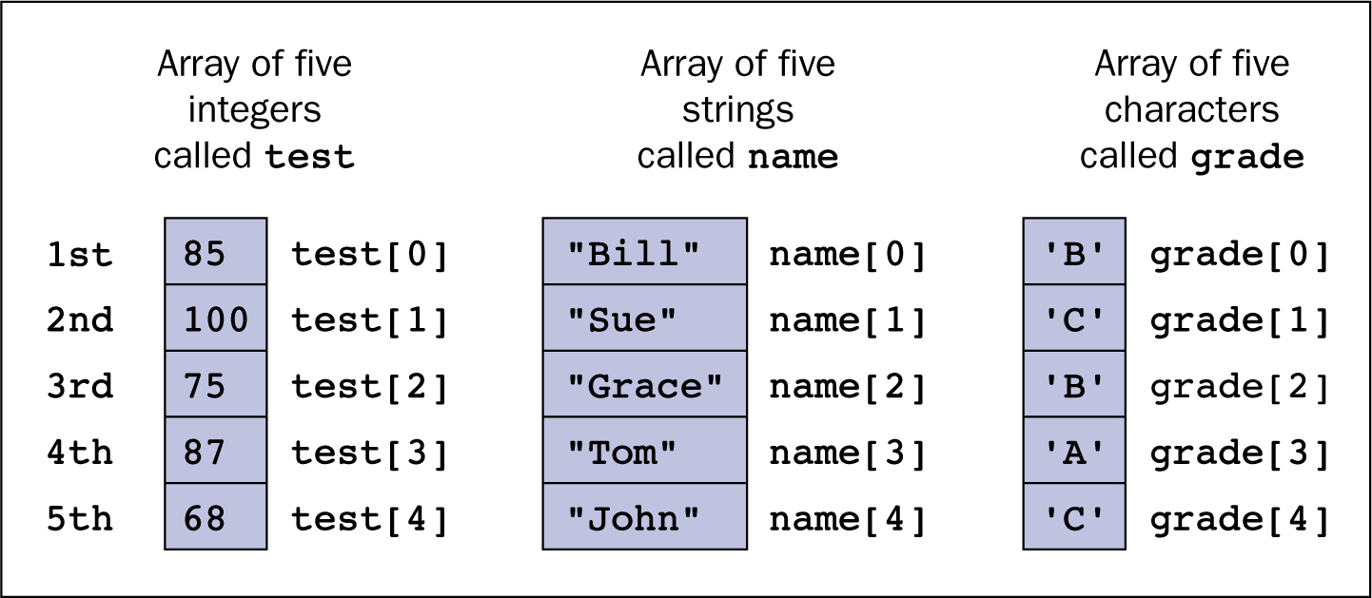
Conceptual Overview (continued)
Three arrays, each containing five elements
‹#›
‹#›

Slide 7
Simple Array Manipulations
The mechanics of manipulating arrays are fairly straightforward.
First, declare and instantiate the array.
<array name>[<index>]
Index must be between 0 and the length minus 1.
The subscript operator ([ ]) has the same precedence as the method selector (.).
‹#›
‹#›

Slide 8
Simple Array Manipulations (continued)
The JVM checks the values of subscripts before using them.
Throws an exception if they are out of bounds (less than 0 or greater than array length minus 1).
The detection of a range-bound error is similar to the JVM’s behavior when a program attempts to divide by 0.
An array’s length is stored in the public instance variable length.
‹#›
‹#›

Slide 9
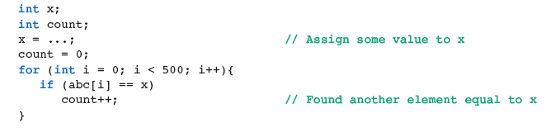
Looping Through Arrays
Traversal: a loop that iterates through an array one element at a time.
Count the Occurrences:
‹#›
‹#›

Slide 10
Looping Through Arrays (continued)
Other examples:
Sum the elements
Determine presence of absence of a number
Determine first location
To work with arrays of any size, use the length instance variable in the loop.
‹#›
‹#›

Slide 11


Declaring Arrays
Example: declaring an array of 500 integers.
Arrays are objects and must be instantiated before using.
‹#›
‹#›

Slide 12
Declaring Arrays (continued)
Array variables are null before they are assigned array objects.
Failure to assign an array object can result in a null pointer exception.
Two variables can refer to the same array.
To have two variables refer to two separate arrays that have the same values, copy all of the elements from one array to the other.
‹#›
‹#›

Slide 13
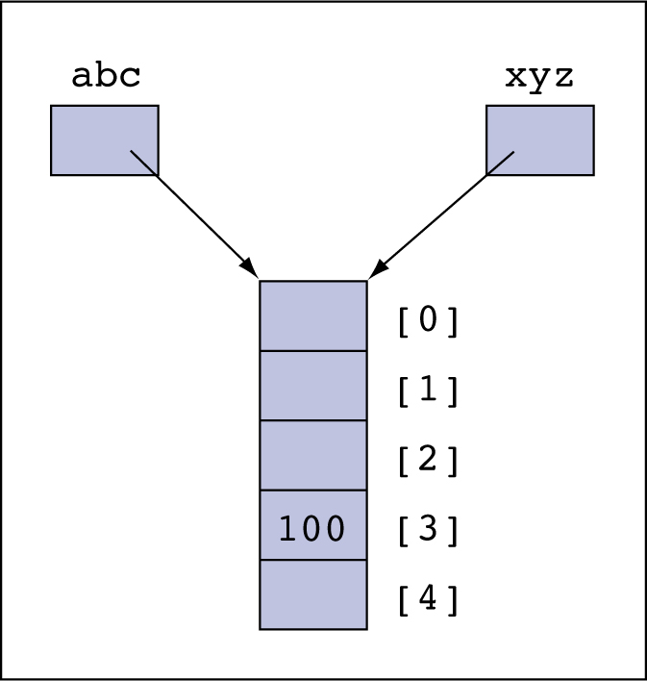
Declaring Arrays (continued)
Two variables can refer to the same array object
‹#›
‹#›

Slide 14
Declaring Arrays (continued)
Because arrays are objects, Java’s garbage collector sweeps them away when they are no longer referenced.
Arrays can be declared, instantiated and initialized in one step.
The list of numbers between the braces is called an initializer list.
‹#›
‹#›

Slide 15
Declaring Arrays (continued)
Arrays can be formed from any collections of similar items.
Booleans, doubles, characters, strings, and students.
Once an array is instantiated, its size cannot be changed, so make sure the array is large enough from the outset.
‹#›
‹#›

Slide 16
Working with Arrays That Are Not Full
When an array is instantiated, the computer fills its cells with default values.
Then the application replaces the values with new ones as needed.
An application might not use all of the cells available in an array.
Physical size: the number of cells in an array.
Logical size: the number of cells being used.
‹#›
‹#›

Slide 17
Working with Arrays That Are Not Full (continued)
Processing Elements in an Array That Is Not Full:
When the array is not full, one must replace the physical length with its logical size.
Adding Elements to an Array:
Place the element to be added directly after the last available item.
Check to see if there is a cell, and change the logical size.
‹#›
‹#›

Slide 18
Working with Arrays That Are Not Full (continued)
Removing Elements from an Array:
Decrement the logical size, which prevents the application from accessing the garbage elements beyond that point.
Arrays and Text Files:
Text files can be used for output and input.
‹#›
‹#›

Slide 19
Parallel Arrays
Parallel arrays: using two arrays in which corresponding elements are related.
Example:
An array includes strings of people’s names.
A second array includes integers of the same people’s ages.
‹#›
‹#›

Slide 20
Using the Enhanced for Loop
An enhanced for loop visits each element in an array from the first position to the last position.
On each pass, the element at the current position is assigned a temporary variable.
The temporary variable has to be compatible with element type of the array.
Allows programmer to skip the use of index variables and other tests.
‹#›
‹#›

Slide 21
Using the Enhanced for Loop (continued)
A break statement can be used to terminate an enhanced for loop early.
Enhanced for loops are simpler and less error-prone than for loops with an index.
‹#›
‹#›

Slide 22
Using the Enhanced for Loop (continued)
The enhanced for loop cannot be used to:
Reverse through an array.
Assign elements to positions in an array.
Track the index position of the current element.
Access any element other than the current element on each pass.
Also, an enhanced for loop shouldn’t be used for an array that’s not filled.
‹#›
‹#›

Slide 23
Arrays and Methods
When an object is used as a parameter to a method, what actually gets passed is a reference to the object.
Not the object itself.
The actual and formal parameters refer to the same object.
Changes made to the object’s state are in effect after the method terminates.
‹#›
‹#›

Slide 24
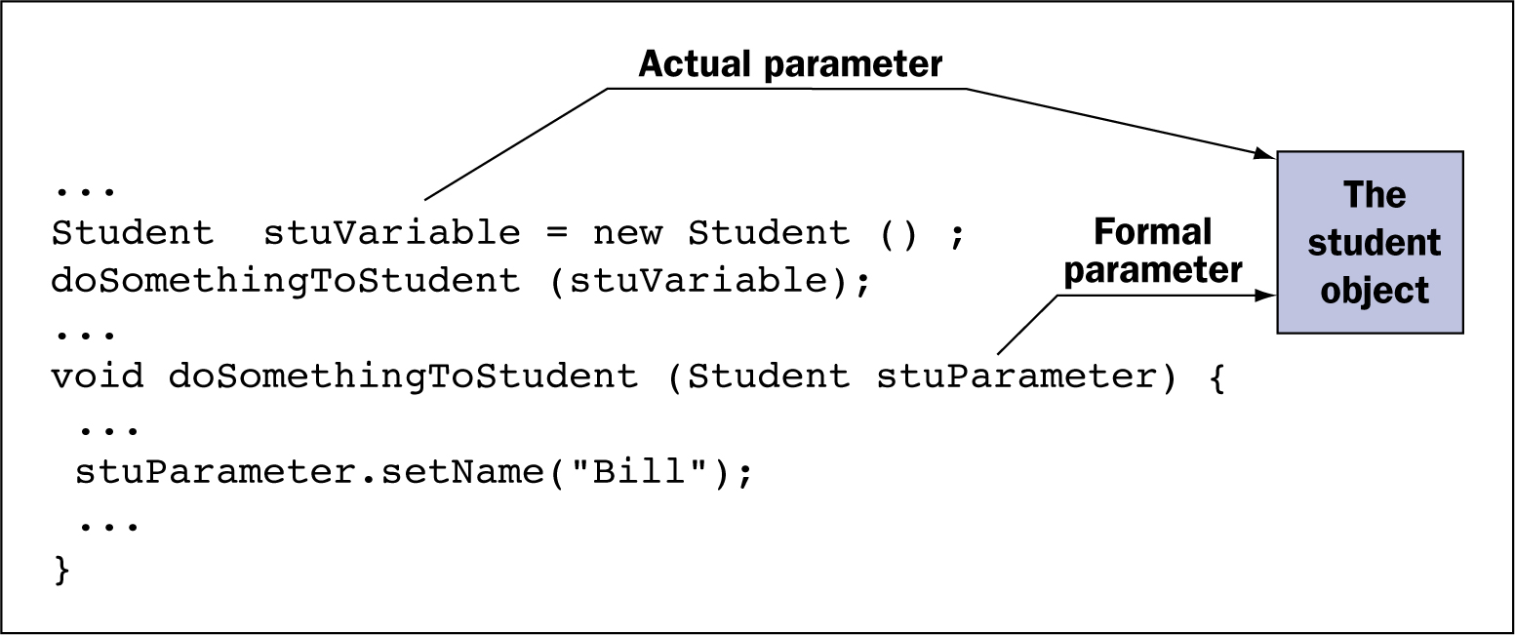
Arrays and Methods (continued)
Passing a reference to an object as a parameter
‹#›
‹#›

Slide 25
Arrays and Methods (continued)
Arrays are objects, so the same rules apply.
When an array is passed as a parameter to a method, the method manipulates the array itself.
Changes made to the array in the method are in effect after the method is executed.
Passing an array to a method leads to trouble if the method mishandles the array.
A method can instantiate a new object or array and return it using the return statement.
‹#›
‹#›

Slide 26
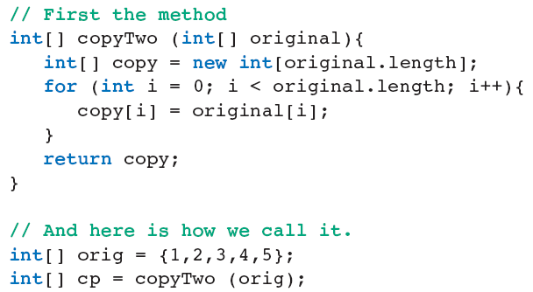
Arrays and Methods (continued)
Example: copy an array.
‹#›
‹#›

Slide 27
Arrays of Objects
Arrays can hold references to objects of any type.
When an array of objects is instantiated, each cell is null by default until reset to a new object.
‹#›
‹#›

Slide 28
Graphics and GUIs: Changing the View of Student Test Scores
Organizing the code between the model and the view splits the code between:
Managing the interface.
Manipulating database.
A GUI interface to view a database needs buttons to support navigating between records.
Also to add or modify records.
‹#›
‹#›

Slide 29
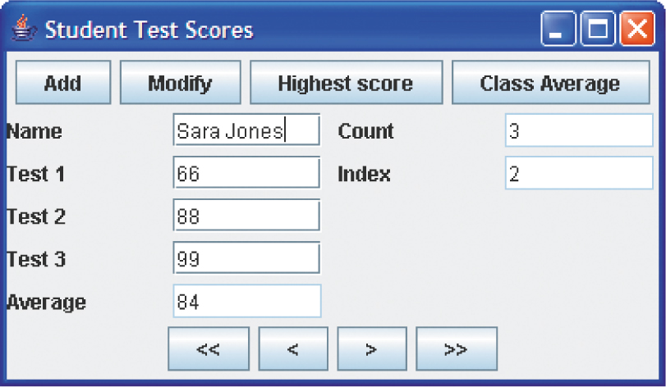
Graphics and GUIs: Changing the View of Student Test Scores (continued)
GUI for the student test scores program
‹#›
‹#›

Slide 30
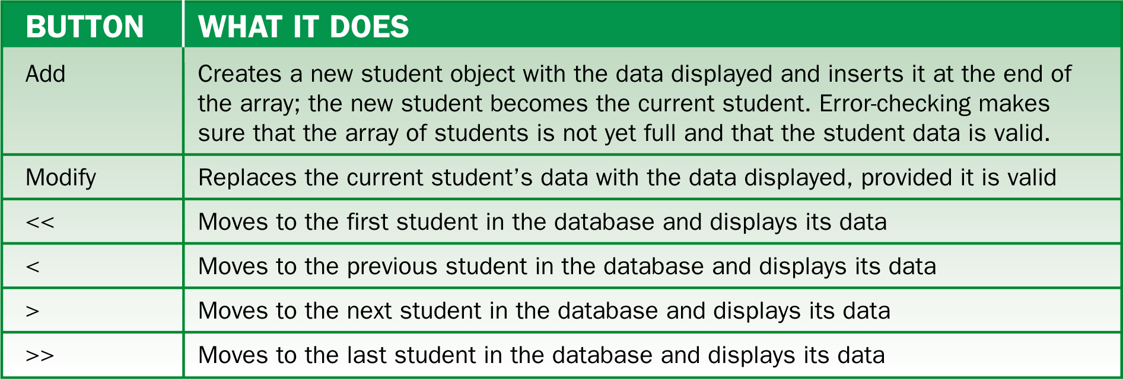
Graphics and GUIs: Changing the View of Student Test Scores (continued)
Description of buttons:
‹#›
‹#›

Slide 31
Design, Testing, and Debugging Hints
To set up an array:
Declare an array variable.
Instantiate an array object and assign it to the array variable.
Initialize the cells in the array with data, as appropriate.
Try to estimate the number of cells needed for an array when creating it.
‹#›
‹#›

Slide 32
Design, Testing, and Debugging Hints (continued)
Array variables are null until assigned objects.
The index of an array cell ranges from 0 to the length of the array minus 1.
To access the last cell, use <array>.length-1.
Avoid having more than one array variable refer to the same array object.
When an array is not full, track the current number of elements.
‹#›
‹#›

Slide 33
Summary
In this chapter, you learned:
Arrays are collections of similar items or elements. The items in arrays are ordered by position.
Arrays are useful when a program needs to manipulate many similar items, such as a group of students or a number of test scores.
‹#›
‹#›

Slide 34
Summary (continued)
Arrays are objects. Thus, they must be instantiated and they can be referred to by more than one variable.
An array can be passed to a method as a parameter and returned as a value.
Parallel arrays are useful for organizing information with corresponding elements.
‹#›
‹#›

Slide 35
Summary (continued)
Two-dimensional arrays store values in a row-and-column arrangement similar to a table.
The enhanced for loop is a simplified version of a loop for visiting each element of an array from the first position to the last position.
‹#›
‹#›

